Slide 1
Code Generation

Slide 2
Code Generation
Final phase of our compiler model
Intermediate Code
Code Generator
Semantically Equivalent
Target Program
Relevant Symbol-Table
Information

Slide 3
Important Issues of Code Generation
Should produce correct Target Program
Preserving Semantic meaning of Source Program
Should produce high quality Target Program
Efficient use of available resources of target program
Should run efficiently

Slide 4
Code Generation & Optimization
To produce optimized target program, compiler may include an optimization phase prior to the generation
Optimizer maps the IR into IR from which efficient code can be generated
Front End
IR
Optimizer
IR
Code Generator
Source Program
Target program
Position of a Code Generator

Slide 5
Issue 1: Input to Code Generator
The intermediate representation (IR) of the source program.
Three address representation
Quadruples
Triples
Indirect triples
Virtual machine representation
Byte codes and stack-machine code
Linear representation
Postfix notations
Graphical representation
Syntax tree and DAG
We will consider Three address representation.

Slide 6
Issue 1: Input to Code Generator
Code generator assumes that
Front end has scanned, parsed, translated the source program into a relatively low level IR
All syntactic and static semantic errors have been detected
The necessary type checking has taken place
Type conversion operators have been inserted

Slide 7
Issue 2: Target Machine and Program
Instruction set architecture of the target machine has significant impact on code generation
The most common machine architectures are:
RISC
Many Registers
Three address instructions
Simple addressing modes
Relatively simple instruction – set architecture
CISC
Few registers
Two address instructions
Variety of addressing modes
Variable length instructions
Stack Based
For example, JVM

Slide 8
Issue 2: Target Machine and Program
Absolute machine code
It can be placed in a fixed location in memory
Can immediately be executed
Relocatable machine – language program
Allows subprograms to be compiled separately
Linker : links a set of Relocatable object modules together
Loader: load them in memory
Assembly language
Easier to generate using of macro and symbolic instruction
However, requires assembly step after code generation

Slide 9
Issue 2: Target Machine and Program
For this chapter
Target Machine
RISC-like computer
Some CISC-like addressing modes
Target Language
Assembly code

Slide 10
Issue 3: Instruction Selection
The code generator must map the IR program into a code sequence that can be executed by the machine
The complexity of performing the mapping is determined by factors such as
The level of the IR
The nature of the ISA (instruction-set architecture)
The desired quality of the generated code
From a set of instructions, we need to select instructions such that
Generated code is correct and efficient
Instruction selection is easy if we don’t care efficiency
For each three address statement, we can design a code skeleton that defines the target code for that construct

Slide 11

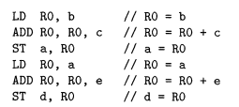

Issue 3: Instruction Selection
Instruction selection for three address statement of form x = y + z can be:
But can produce redundant loads and stores
Three address statements
Translated Code

Slide 12

Issue 3: Instruction Selection
On most machines, a given IR can be translated in many different ways
Some may be efficient, some not
Example statement: a = a + 1
If the target machine has an INC instruction, then we have two ways to implement for that machine
(i)
(ii)

Slide 13
Issue 4: Register Allocation
Registers are the fastest computational unit but we do not have enough of them
Values not held in register need to reside in memory
Instruction involving register operands are shorter and faster
What values to hold in what registers??

Slide 14
Issue 4: Register Allocation
Use of registers is subdivided into –
Register allocation: select the set of variables that will reside in registers at each point in the program
Register assignment: we pick a register that a variable will reside in.
Finding an optimal assignment of registers to variables is difficult
NP-complete

Slide 15
Issue 5: Evaluation Order
Evaluation order can affect the efficiency of the target code
Some ordering requires fewer registers to hold intermediate results
Finding the best order is difficult
NP-complete

Slide 16
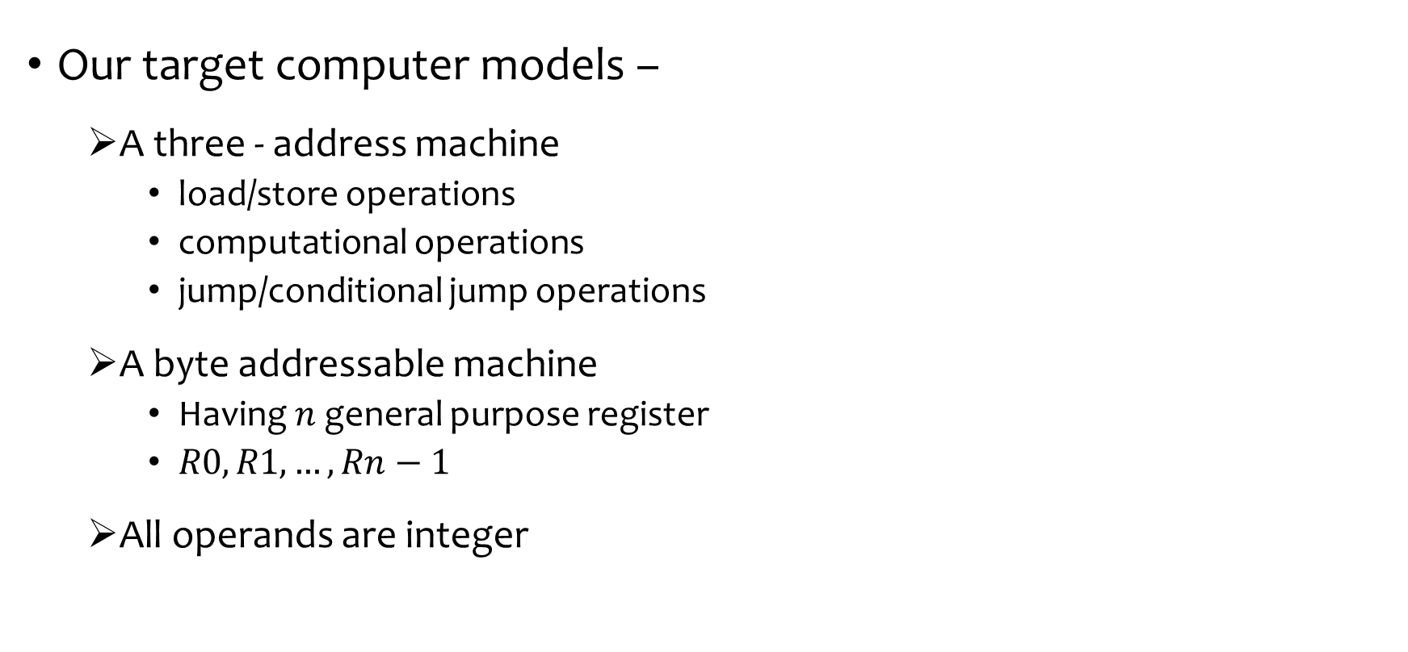
A Simple Target Machine Model
Our target computer models –
A three - address machine
load/store operations
computational operations
jump/conditional jump operations
A byte addressable machine
Having $n$ general purpose register
$R0, R1, …, Rn−1$
All operands are integer

Slide 17
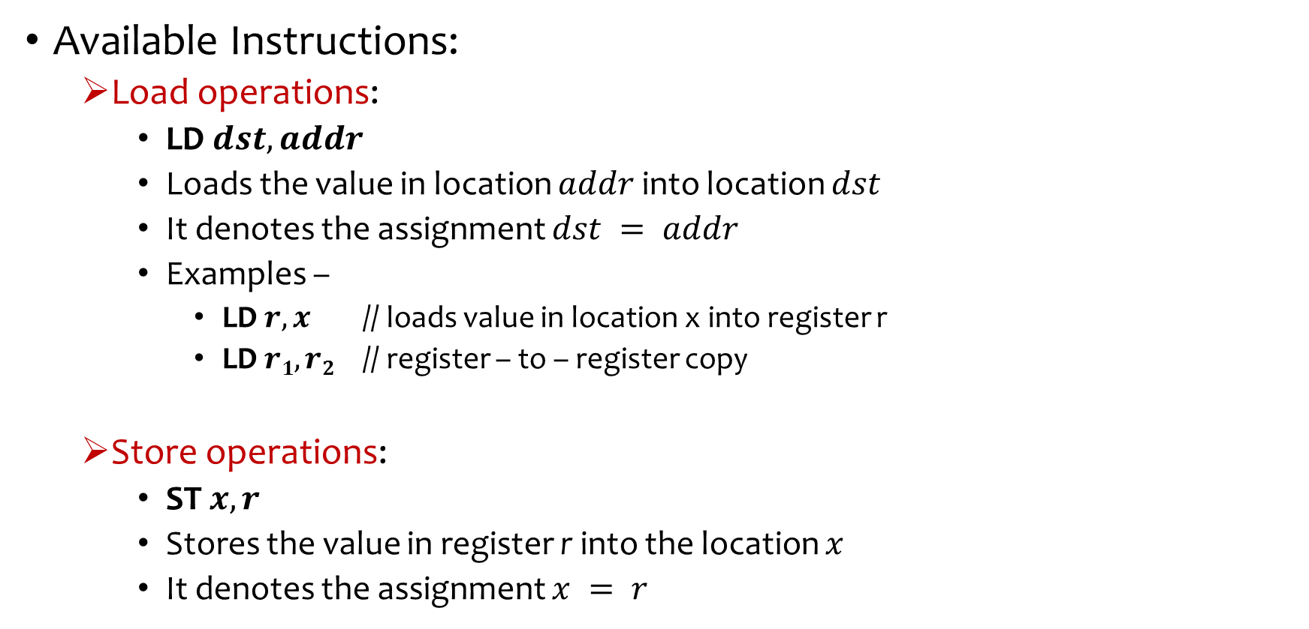
A Simple Target Machine Model
Available Instructions:
Load operations:
LD $dst, addr$
Loads the value in location $addr$ into location $dst$
It denotes the assignment $dst = addr$
Examples –
LD $r, x$ // loads value in location x into register r
LD $r1, r2$ // register – to – register copy
Store operations:
ST $x, r$
Stores the value in register r into the location $x$
It denotes the assignment $x = r$

Slide 18
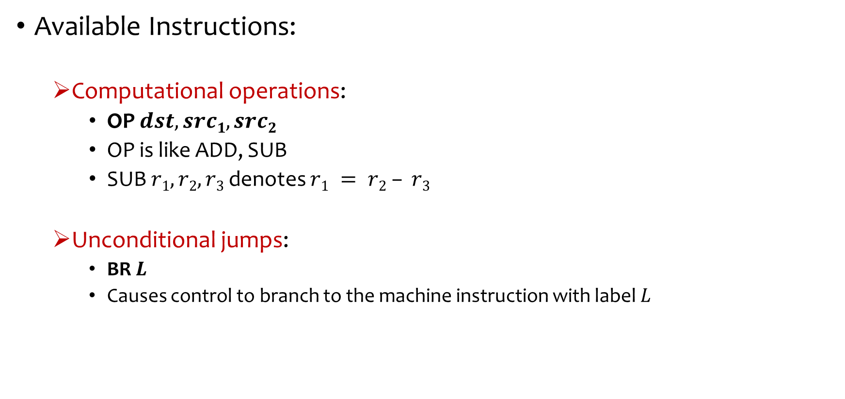
A Simple Target Machine Model
Available Instructions:
Computational operations:
OP $dst, src1, src2$
OP is like ADD, SUB
SUB $r1, r2, r3$ denotes $r1 = r2 – r3$
Unconditional jumps:
BR $L$
Causes control to branch to the machine instruction with label $L$

Slide 19

A Simple Target Machine Model
Available Instructions:
Conditional jumps:
Bcond $r, L$
Here $r$ is a register
cond stands for a common tests on value in register $r$
Example:
BLTZ $r,L$
Jump to lable$L$ if the value of $r$ is less than $0$

Slide 20
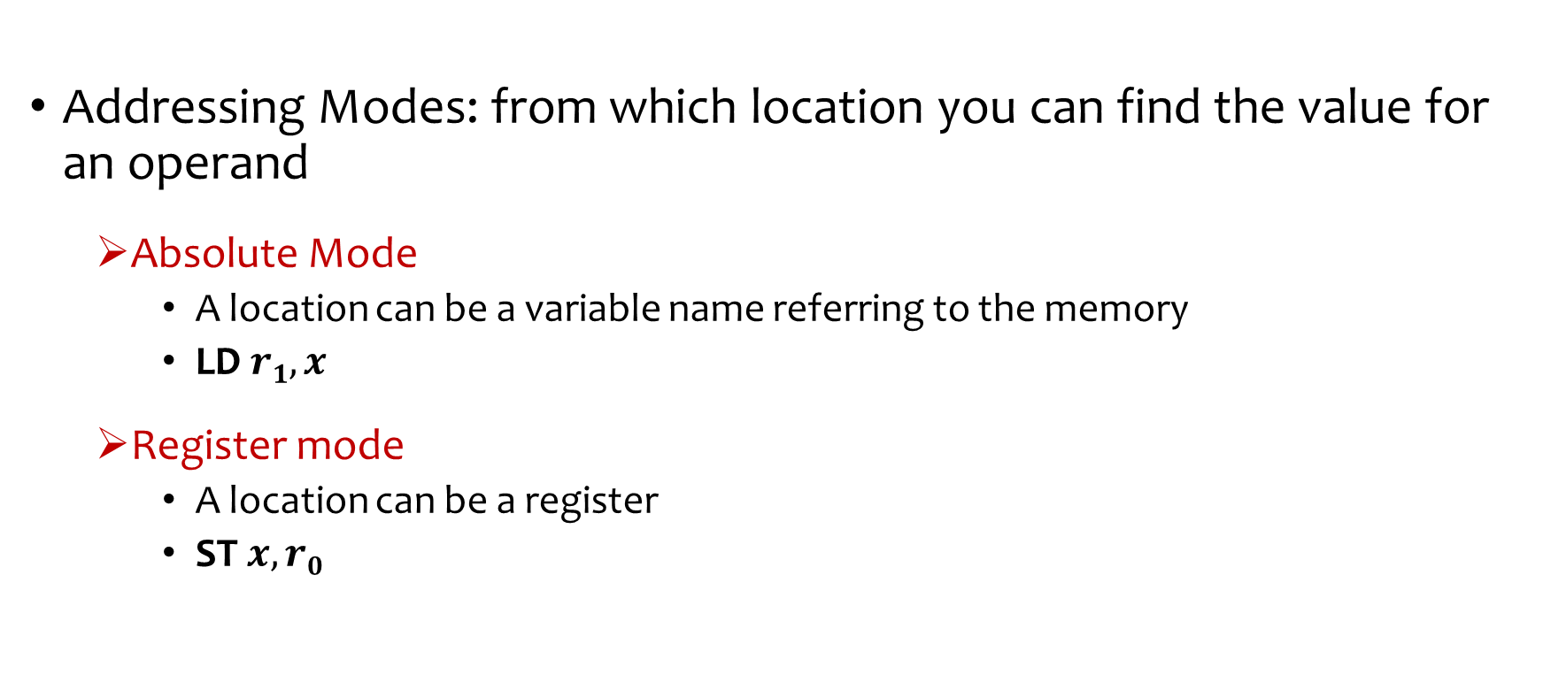
Addressing Modes
Addressing Modes: from which location you can find the value for an operand
Absolute Mode
A location can be a variable name referring to the memory
LD $r1, x$
Register mode
A location can be a register
ST $x, r0$

Slide 21
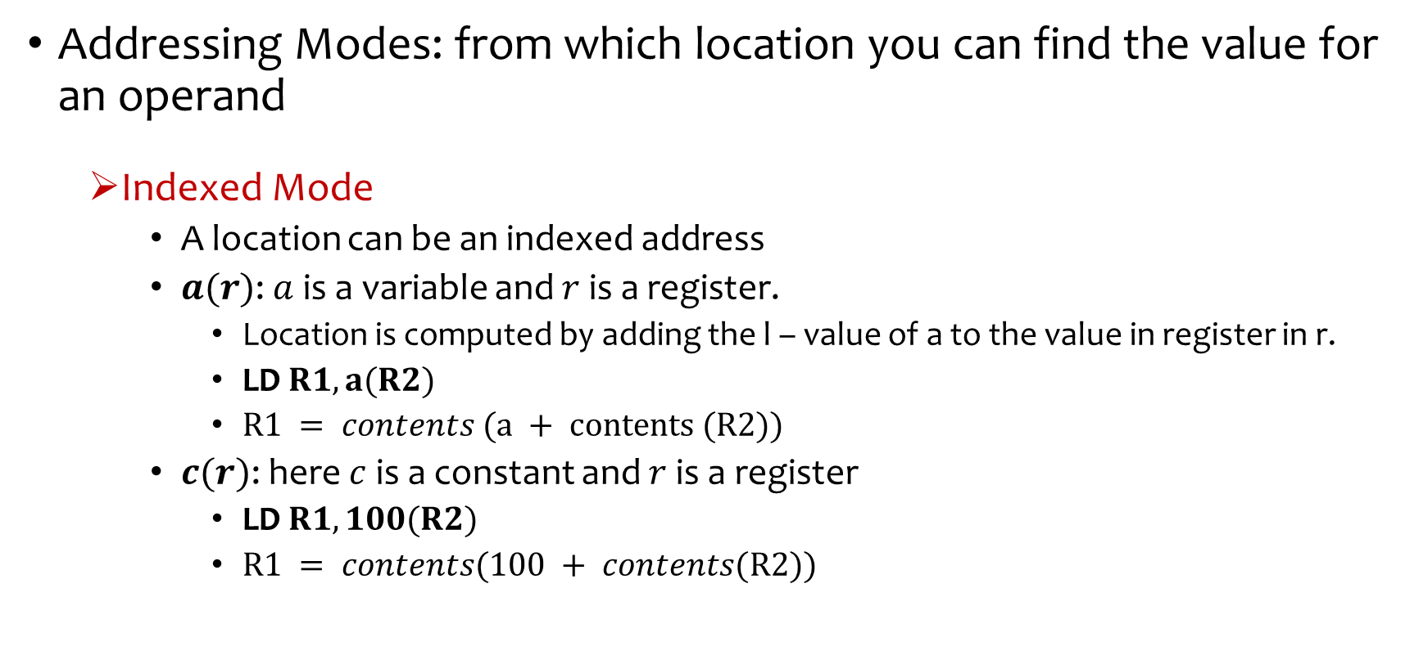
Addressing Modes
Addressing Modes: from which location you can find the value for an operand
Indexed Mode
A location can be an indexed address
$a(r)$: $a$ is a variable and $r$ is a register.
Location is computed by adding the l – value of a to the value in register in r.
LD $R1, a(R2)$
$R1 = contents (a + contents (R2))$
$c(r)$: here $c$ is a constant and $r$ is a register
LD $R1, 100(R2)$
$R1 = contents(100 + contents(R2))$

Slide 22
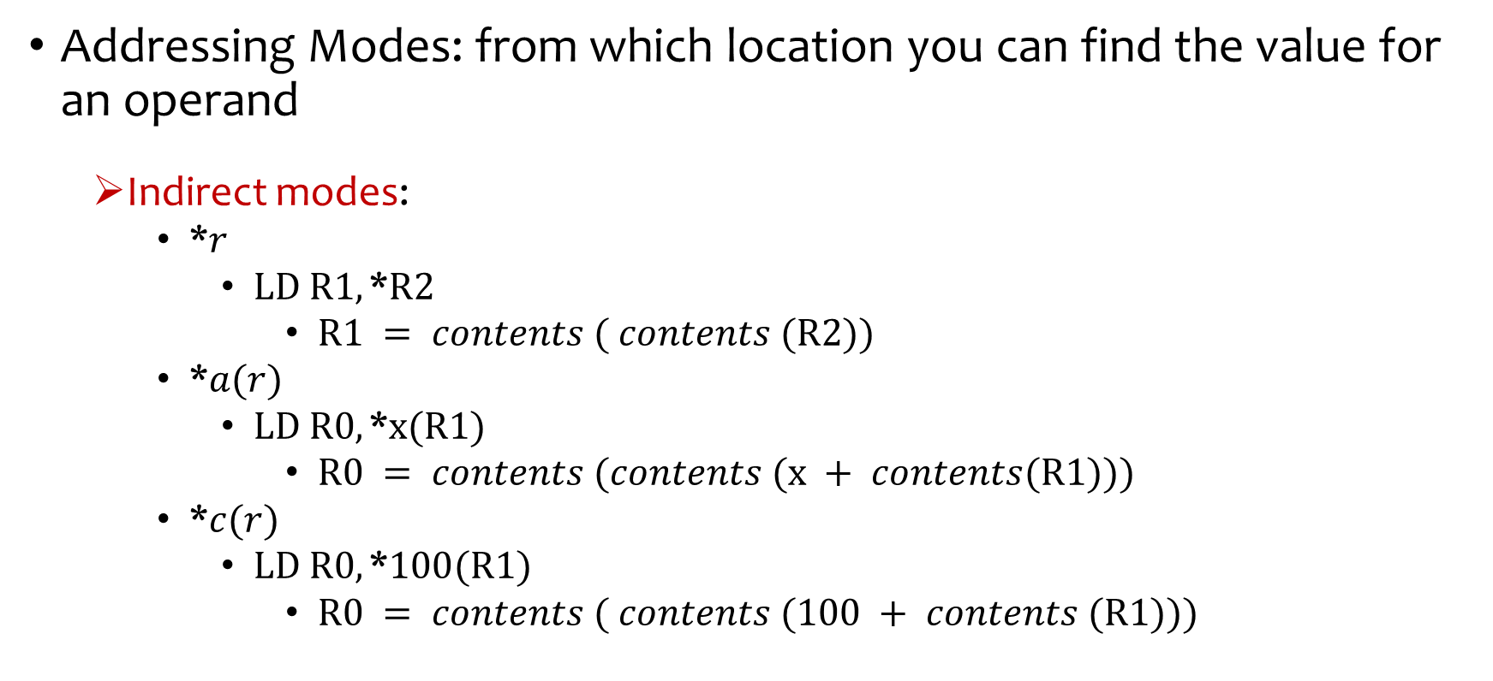
Addressing Modes
Addressing Modes: from which location you can find the value for an operand
Indirect modes:
*$r$
$LD R1,\text{∗}R2$
$R1 = contents ( contents (R2))$
*$a(r)$
$LD R0,\text{∗}x(R1)$
$R0 = contents (contents (x + contents(R1)))$
*$c(r)$
$LD R0,\text{∗}100(R1)$
$R0 = contents ( contents (100 + contents (R1)))$

Slide 23
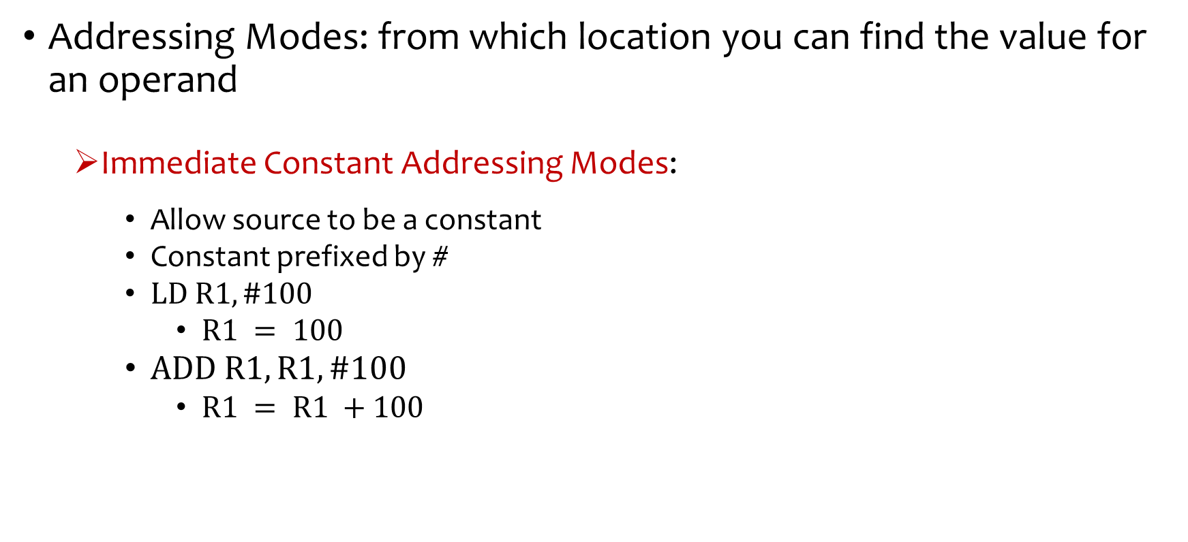
Addressing Modes
Addressing Modes: from which location you can find the value for an operand
Immediate Constant Addressing Modes:
Allow source to be a constant
Constant prefixed by #
$LD R1, \#100$
$R1 = 100$
$ADD R1, R1, \#100$
$R1 = R1 +100$

Slide 24
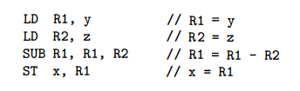

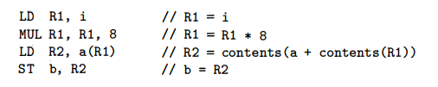
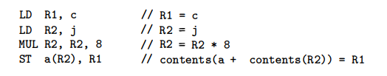
Statement-wise Code Generation
IR (TAC)
Target Code

Slide 25



Statement-wise Code Generation
IR (TAC)
Target Code

Slide 26
Program Cost
A cost is often associated with compiling and running program
Common cost measure may be-
Compilation time
Size of the target program
Running-time of the target program
Power consumption of the target program

Slide 27
Instruction Cost
Simple model for instruction cost
Cost of an instruction = One plus cost for the addressing modes.
Addressing modes –
involving registers have zero additional cost
involving a memory location / constant have an additional cost
Since such operands have to be stored in the words following the instruction

Slide 28
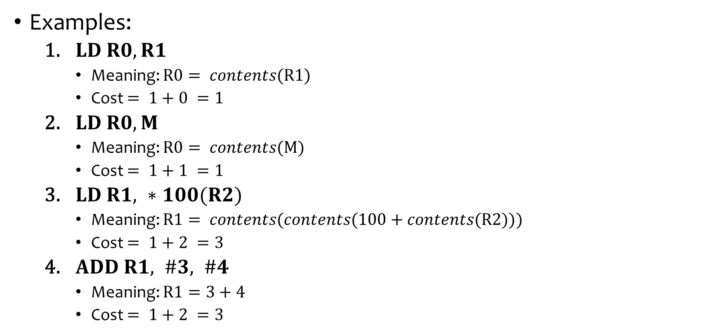
Instruction Cost
Examples:
$LD R0, R1$
Meaning: $R0= contents(R1)$
Cost $= 1+0 =1$
$LD R0, M$
Meaning: $R0= contents(M)$
Cost $= 1+1 =1$
$LD R1, ∗100(R2)$
Meaning: $R1= contents(contents(100+contents(R2)))$
Cost $= 1+2 =3$
$ADD R1, \#3, \#4$
Meaning: $R1=3+4$
Cost $= 1+2 =3$

Slide 29
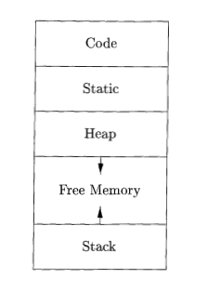
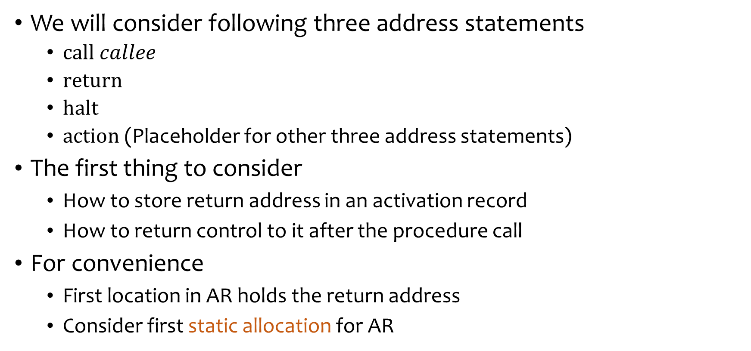
Code Generation for Function Call
We will consider following three address statements
$call callee$
$return$
$halt$
$action$ (Placeholder for other three address statements)
The first thing to consider
How to store return address in an activation record
How to return control to it after the procedure call
For convenience
First location in AR holds the return address
Consider first static allocation for AR

Slide 30



Static Allocation
$call callee$
$callee.staticArea$ is the address of the beginning of the AR of callee
$\#here$ is the address of current instruction
$return$

Slide 31
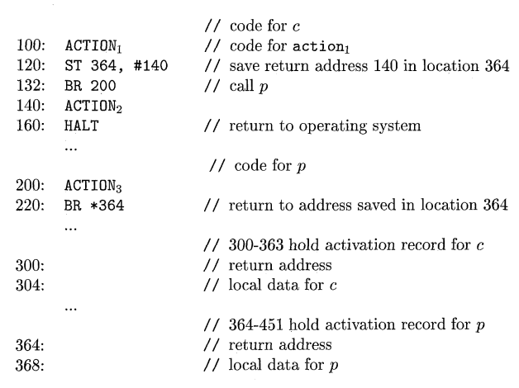
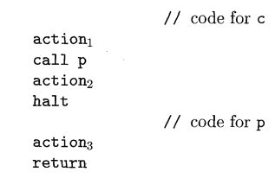
Static Allocation
Example:
Three Address Code
Target Code for Static Allocation

Slide 32
Stack Allocation
Use relative address for storage in activation record
Position of activation record in the control stack is not fixed
It can be accessed by offsets from a known position
Maintain register SP to points to the beginning of the activation record on top of the stack
Calling procedure adjust SP

Slide 33



Stack Allocation
Stack Initialization
Done by first procedure
$call callee$
$return$
Code in callee
Code in caller

Slide 34
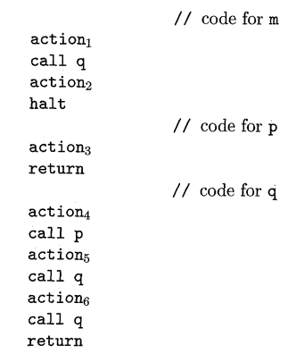
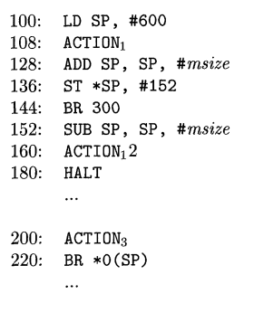
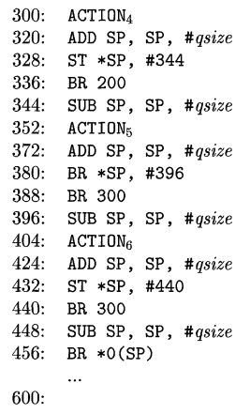
Stack Allocation
Three Address Code
Target code for stack allocation

Slide 35
Run-time Addresses For Names
Addresses for Global Variables
Source Code
Target Code
(x86-64 clang 8.0.0, after compiling to binary and then disassembly)
int a;
long b;
char c;
int w[2];
int main(){
a=1;
b=2;
c='a';
w[0]=5;
w[1]=6;
return 0;
}
… … …
mov DWORD PTR ds:0x601030,0x1
mov QWORD PTR ds:0x601038,0x2
mov BYTE PTR ds:0x601040,0x61
mov DWORD PTR ds:0x601044,0x5
mov DWORD PTR ds:0x601048,0x6
… … …
From godbolt.org

Slide 36
Run-time Addresses For Names
Addresses for Local Variables
Source Code
Target Code
(x86-64 clang 8.0.0)
int main(){
int a;
long b;
char c;
int w[2];
a=1;
b=2;
c='a';
w[0]=5;
w[1]=6;
return 0;
}
… … …
mov dword ptr [rbp - 8], 1
mov qword ptr [rbp - 16], 2
mov byte ptr [rbp - 17], 97
mov dword ptr [rbp - 28], 5
mov dword ptr [rbp - 24], 6
… … …
From godbolt.org

Slide 37
Basic Blocks & Flow Graphs
Flow graph is a graphical representation of IR
Helps in Code Generation
Better job in Register Allocation
Better job in Instruction Selection

Slide 38
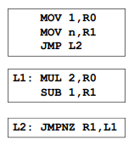
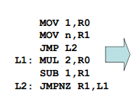
Basic Blocks
Maximal sequences of consecutive Three-Address instructions with the properties –
The flow of control can only enter the basic block through the first instruction in the block
There are no jumps into the middle of the bock
Control will leave the block without halting or branching
Except possibly at the last instruction in the block

Slide 39
Flow Graphs
Graphical depiction of sequence of instructions with control flow edges
A graph with
Basic Blocks are nodes
Branches are directed edges

Slide 40
Constructing Basic Blocks
Algorithm: Partitioning Three-Address Code into Basic Blocks
Input: A sequence of Three-Address Code
Output: A list of basic blocks where each instruction is assigned to exactly one block
Method:
Determine those instructions in the intermediate code that are the first instructions in some basic blocks – leaders
The first instruction in a sequence is a leader
Any instruction that is the target of a branch is a leader
Any instruction that follows a branch is a leader
For each leader, basic block consists codes upto next leader or end

Slide 41
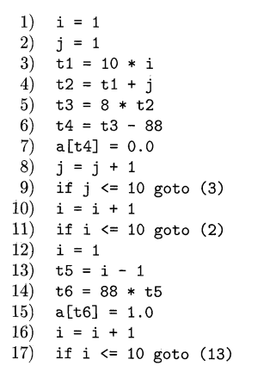
Constructing Basic Blocks
Method:
Determine those instructions in the intermediate code that are the first instructions in some basic blocks – leaders
The first instruction in a sequence is a leader
Any instruction that is the target of a branch is a leader
Any instruction that follows a branch is a leader
For each leader, basic block consists codes upto next leader or end
Leader (Rule 1)
B₁
B₂
Leader (Rule 2)
B₃
Leader (Rule 2)
Leader (Rule 3)
B₄
B₅
Leader (Rule 3)
B₆
Leader (Rule 2)

Slide 42
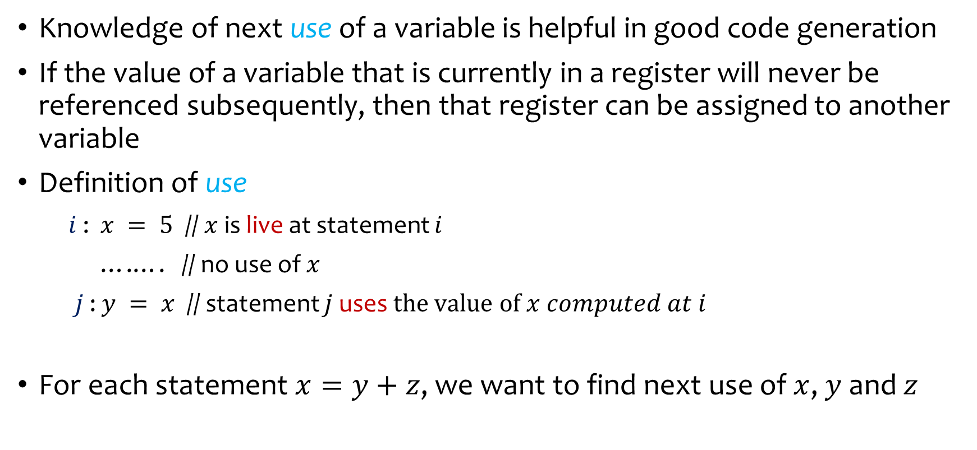
Liveliness & Next-Use Information
Knowledge of next use of a variable is helpful in good code generation
If the value of a variable that is currently in a register will never be referenced subsequently, then that register can be assigned to another variable
Definition of use
$i$ : $x = 5$ // $x$ is live at statement $i$
….…. // no use of $x$
$j$ : $y = x$ // statement $j$ uses $the value of x computed at i$
For each statement $x=y+z$, we want to find next use of $x$, $y$ and $z$

Slide 43
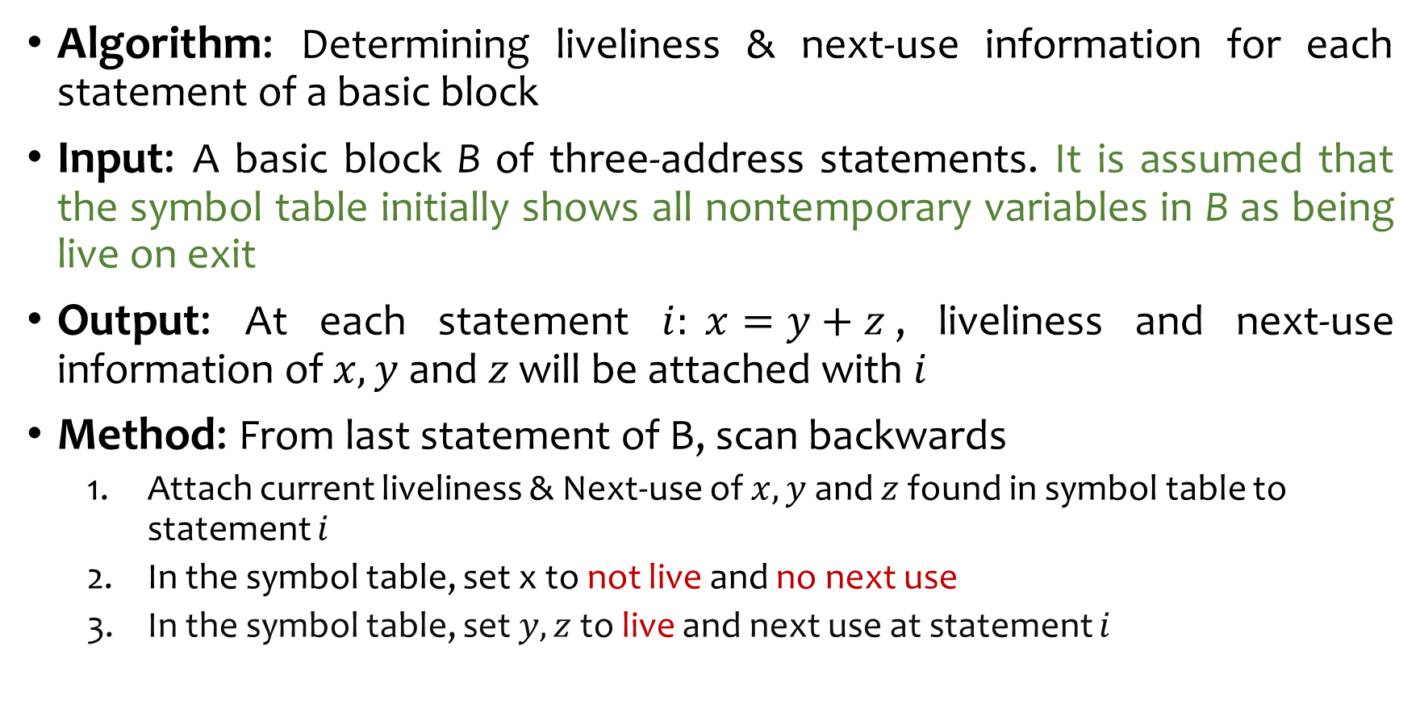
Liveliness & Next-Use Information
Algorithm: Determining liveliness & next-use information for each statement of a basic block
Input: A basic block B of three-address statements. It is assumed that the symbol table initially shows all nontemporary variables in B as being live on exit
Output: At each statement $i: x=y+z$, liveliness and next-use information of $x,y$ and $z$ will be attached with $i$
Method: From last statement of B, scan backwards
Attach current liveliness & Next-use of $x,y$ and $z$ found in symbol table to statement $i$
In the symbol table, set x to not live and no next use
In the symbol table, set $y,z$ to live and next use at statement $i$

Slide 44
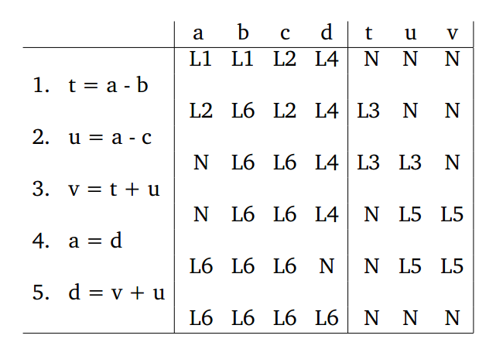
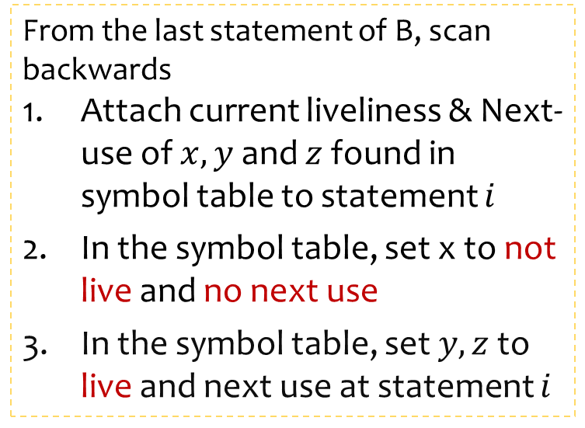
Liveliness & Next-Use Information
From the last statement of B, scan backwards
Attach current liveliness & Next-use of $x,y$ and $z$ found in symbol table to statement $i$
In the symbol table, set x to not live and no next use
In the symbol table, set $y,z$ to live and next use at statement $i$

Slide 45
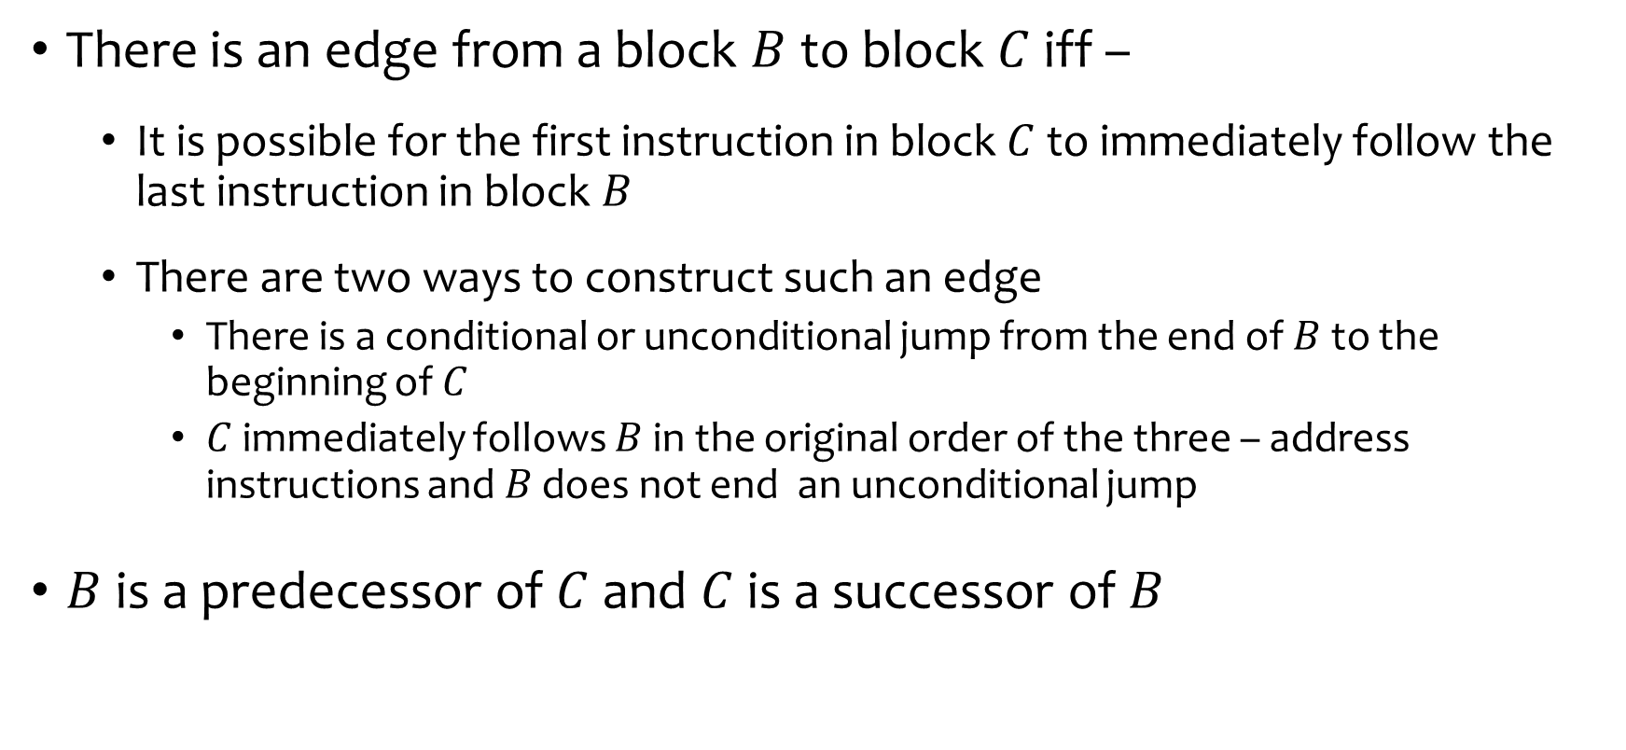
Flow Graphs
There is an edge from a block $B$ to block $C$iff –
It is possible for the first instruction in block $C$ to immediately follow the last instruction in block $B$
There are two ways to construct such an edge
There is a conditional or unconditional jump from the end of $B$ to the beginning of $C$
$C$ immediately follows $B$ in the original order of the three – address instructions and $B$ does not end an unconditional jump
$B$ is a predecessor of $C$ and $C$ is a successor of $B$

Slide 46
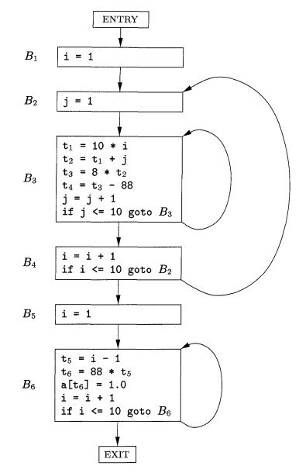
Flow Graphs

Slide 47
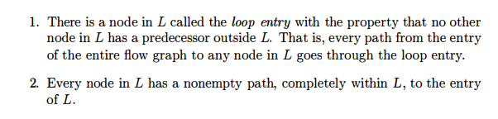

Loops
A set of nodes L in the flow graph is a loop if
Example:

Slide 48
Optimization of Basic Blocks
Optimization within each basic block is also called local optimization
Example:
Common Subexpression Elimination
Dead Code Elimination
Reducing the time of a temporary variable to be in a register
Simplify Algebraic Computation

Slide 49
DAG representation of Basic Blocks
Many important techniques for local optimization begin by transforming a basic block into a DAG
We can construct DAG for a basic block as follows
There is a node in the DAG for each of the initial values of the variables appearing in the basic block
There is a node N associated with each statement s within the block. The children of N are those nodes corresponding to statements that are the last definitions, prior or s, of the operands used by s
Node N is labeled by the operator applied at s, and also attached to N is the list of variables for which it is the last definition within the block
Certain nodes are designated output nodes. These are the nodes whose variables that are live on exit from the block

Slide 50

DAG representation of Basic Blocks
There is a node in the DAG for each of the initial values of the variables appearing in the basic block
There is a node N associated with each statement s within the block. The children of N are those nodes corresponding to statements that are the last definitions, prior or s, of the operands used by s
Node N is labeled by the operator applied at s, and also attached to N is the list of variables for which it is the last definition within the block
Certain nodes are designated output nodes. These are the nodes whose variables that are live on exit from the block

Slide 51
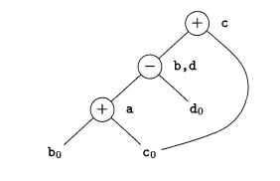

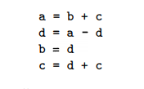
Eliminate Local Common Subexpressions
b is not live on exit
b is live on exit

Slide 52
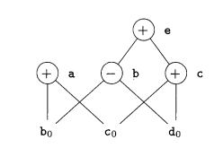

Finding Local Common Subexpressions
Another Example:
What will happen in this case?
DAG method will fail to recognize detect common subexpression of 1st and 4th instruction

Slide 53
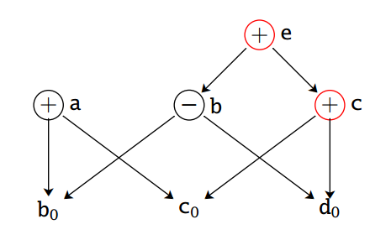
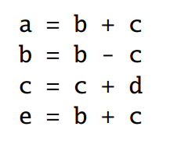
Dead Code Elimination
Eliminate instructions that compute values that are never used
Delete the nodes with no ancestor and no attached live variables from the DAG
Assuming e and c are not live on exit

Slide 54

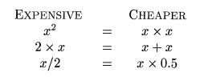
Use of Algebraic Identities
Apply algebraic identities to eliminate computation
Local reduction in strength
Constant Folding by evaluating constant expressions at compile time
Example: replace 2*3.14 by 6.28

Slide 55
Use of Algebraic Identities
Commutativity with local common subexpression
Associativity with composite expression
a = x*y
b = y*x
a = x*y
b = a
Assuming t is not live on exit
a = b+c
t = c+d
e = t+b
a = b+c
b = c+d+b
a = b+c
e = a+d

Slide 56

Representation of Array References

Slide 57
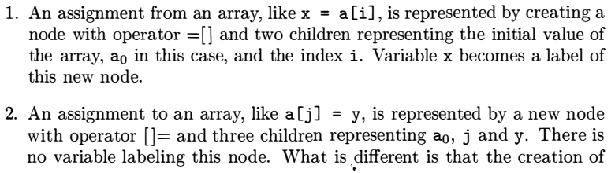

Representation of Array References

Slide 58
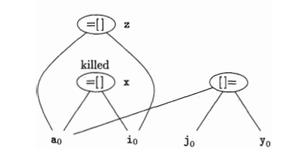
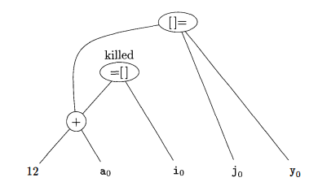

Representation of Array References

Slide 59
Simple Code-Generation Algorithm
Generates code for a single basic block
Consider each three-address instruction in turn
Keep track of what values are in what registers
Avoid generating unnecessary loads and stores
Assumes -
the basic block has already been optimized
some set of registers are available to hold values within blocks
there is exactly one machine instruction for each operator that accepts the operands from registers and stores the result in a registers
Machine instructions are of the forms
LD reg, mem
ST mem, reg
OP reg, reg, reg

Slide 60
Register and Address Descriptors
Register Descriptor
One for each register
Keeps track of the variable names whose current value is in the register
Initially all are set to empty
Address Descriptor
One for each program variable
Keeps track of the location or locations where the current value of that variable can be found
Locations can be a register, a memory address, a stack location
Can be a set of more than one of the above
Can be stored in the symbol table entry of the variable

Slide 61
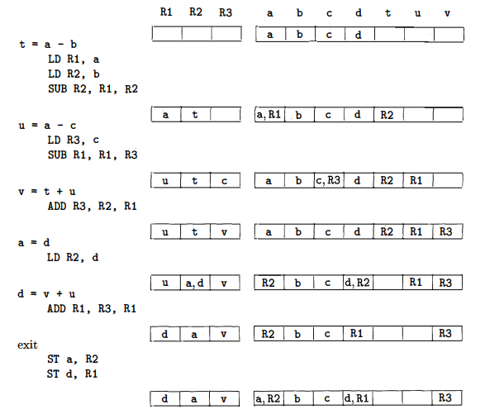
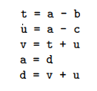
An Example of Code-Generation
IR (TAC)
Gen. Code
getReg(I)
Register Descriptors
Address Descriptors
{R2, R1, R2}
{R1, R1, R3}

Slide 62
An Example of Code-Generation
IR (TAC)
Gen. Code
getReg(I)
Register Descriptors
Address Descriptors
{R3, R2, R1}
{R2, R2}
{R1, R3, R1}

Slide 63
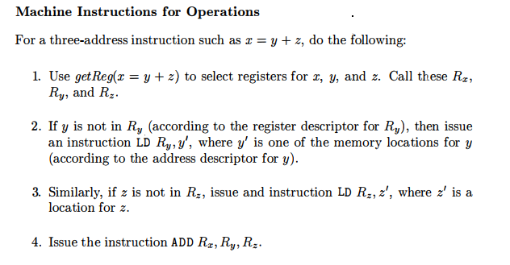
The Code-Generation Algorithm
Machine instructions for operations

Slide 64
The Code-Generation Algorithm
Machine instructions for Copy Statements
Assumes getReg(I) will always generate the same register for x and y
If y is not already in Ry, then generate instruction LD Ry, y
Else only update the register descriptor for Ry
Ending the basic block
Variables used in a block may wind up with their only location being a register
For temporary variables within a block, do nothing
For each variable x that is live on exit from the block, generate instruction
ST x, R where R is the register that stores x’s value

Slide 65
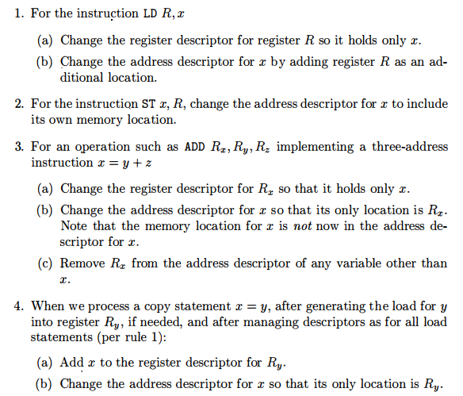
Managing Register and Address Descriptors

Slide 66
Managing Register and Address Descriptors

Slide 67
Design of Function getReg(I)
For variable y ( and z as well) in the expression x=y+z
If y is currently in a register, pick that register as Ry
Else if y is not in a register and there are empty registers, pick an empty register as Ry
Else if y is not in a register and there are no empty registers, then
- for each register R
- For each variable v that are in R
- If v is somewhere besides R (check from address descriptor), pick R
- Else if v is x, and x is not one of the other operands (z), pick R
- Else if v is not used later, pick R
- Else generate a store instruction ST v, R; called a spill
Since R may hold several variables at the moment, calculate R’s score as total number of spills required for all its variables
- pick the register R with lowest score as Ry

Slide 68
Design of Function getReg(I)
For variable x in the expression x=y+z
- The issues and options are almost as for y, except for the following differences
- A register that holds only x is always an acceptable choice for R_{x}
- holds true even if x is one of y and z
- If y is not used after instruction I and R_{y} holds only y after being loaded, if necessary then pick R_{y} as R_{x}
- similar option holds regarding z and R_{z}
- If I is a copy instruction (x=y), always choose R_{y} as R_{x}

Slide 69
Demo (from godbolt.org)
Target Code
(MIPS64 gcc 5.4 without O1 switch)
Target Code
(MIPS64 gcc 5.4 with O1 switch)
Source Code
int a, b, c, d, e, f, g;
int main(){
a=b*c;
b=1;
return 0;
}
… … …
ld $2,%got_disp(b)($4)
lw $3,0($2)
ld $2,%got_disp(c)($4)
lw $2,0($2)
mult $3,$2
mflo $3
ld $2,%got_disp(a)($4)
sw $3,0($2)
ld $2,%got_disp(b)($4)
li $3,1 # 0x1
sw $3,0($2)
… … …
… … …
ld $3,%got_disp(b)($5)
lw $2,0($3)
ld $4,%got_disp(c)($5)
lw $4,0($4)
mul $2,$2,$4
ld $4,%got_disp(a)($5)
sw $2,0($4)
li $2,1 # 0x1
sw $2,0($3)
… … …
Multiple loads of variable b
All variables are loaded only once

Slide 70
Peephole Optimization
Peephole
- a small sliding window of target instructions
Replace instructions in peephole with shorter and faster sequence
Can be applied on Intermediate code or assembly code
Repeated passes result in better optimization

Slide 71

Peephole Optimization
Redundant-instruction elimination

Slide 72



Peephole Optimization
Eliminating unreachable code
Eliminating jump over jumps
If debug is initialized to zero, then using constant propagation
Eliminating unreachable code

Slide 73






Peephole Optimization
Flow-of-control optimization

Slide 74

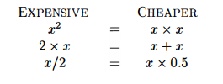
Peephole Optimization
Algebraic Simplification
Reduction in strength

Slide 75
Peephole Optimization
Use of machine idioms
x= x + 1
x++

Slide 76
Reference
Compilers: Principles, Techniques, & Tools, by
Alfred B. Aho, Monica S. Lam, Ravi Sethi, Jeffrey D. Ullman
Chapter 8
8.1
8.2
8.3
8.4
8.5
8.6
8.7

Slide 77
Thank You!

